Slide 1
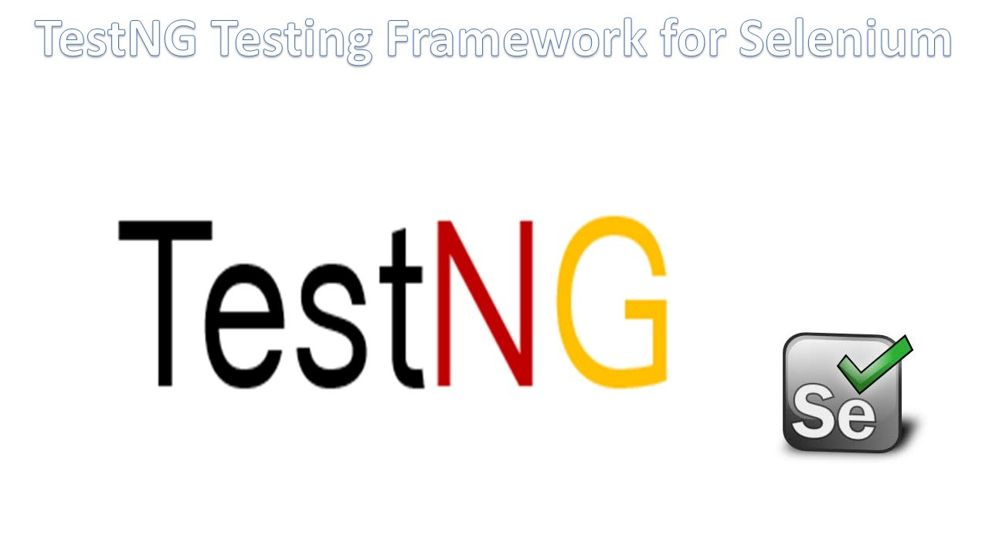

Slide 2
TestNG Framework
TestNG is an open source automated Testing framework. In TestNG, NG stands for "Next Generation".
TestNG is a very important framework when you are actually developing the framework from scratch level.
TestNG provides you full control over the test cases and the execution of the test cases. Due to this reason, TestNG is also known as a testing framework.
Cedric Beust is the developer of a TestNG framework.
If you want to run a test case A before that as a pre-request you need to run multiple test cases before you begin a test case A. You can set and map with the help of TestNG so that pre-request test cases run first and then only it will trigger a test case A. In such way, you can control the test cases.
TestNG framework came after Junit, and TestNG framework adds more powerful functionality and easier to use.

Slide 3
Advantages of TestNG over Junit
In TestNG, annotations are easier to understand than Junit.
It produces the HTML, Emailable reports after the execution.
In TestNG, there is no constraint available such as @beforeclass and @afterclass which is present in Junit.
TestNG enables you to group the test cases easily which is not possible in JUnit.
TestNG supports three additional levels such as @Before/After suite, @Before/AfterTest, and Before/AfterGroup.
TestNG does not extend any class. TestNG framework allows you to define the test cases where each test case is independent of other test cases.
We can Prioritize the test case also which is not possible in Junit f/w.

Slide 4
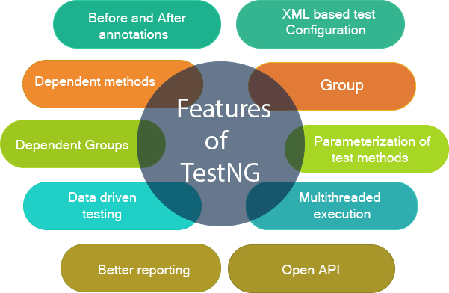

Slide 5
Installation of TestNG with Eclipse: We can install TestNG with Eclipse in 3 different ways.
1. Directly from Official website of TestNG
2. From Eclipse Market Place
3. Maven Repo

Slide 6
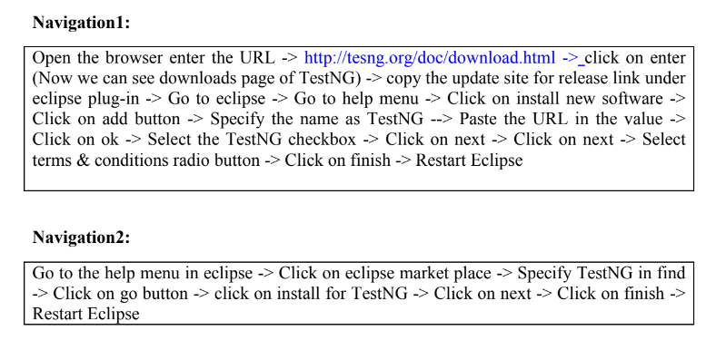

Slide 7
List of Annotations in TestNG
Annotation: Annotations are nothing but predefine classes which contains reusable code.
Every annotations starts with ‘@’ symbol
@BeforeSuite
@AfterSuite
@BeforeTest
@AfterTest
@BeforeClass
@AfterClass
@BeforeMethod
@AfterMethod
@Test
@Ignore

Slide 8
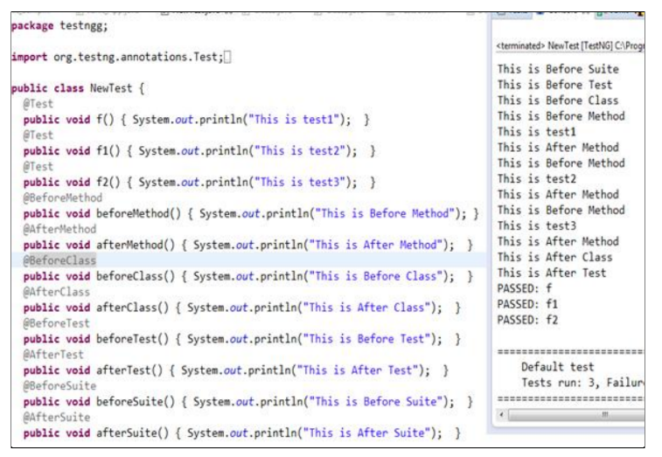

Slide 9
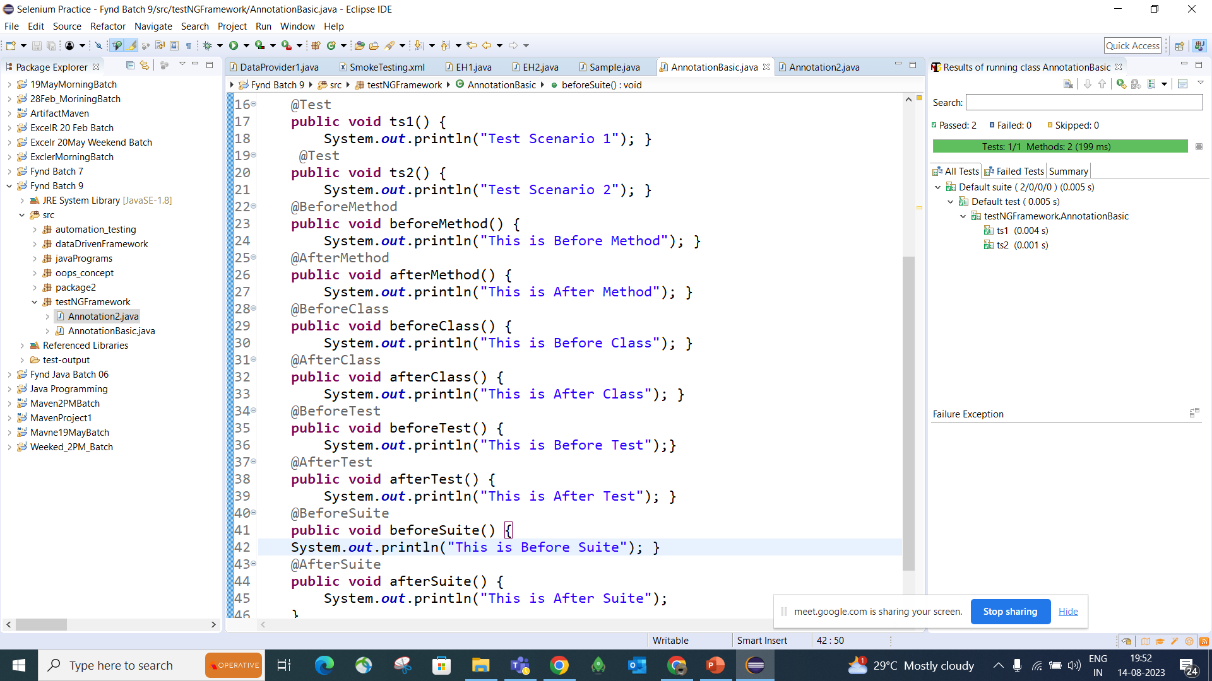

Slide 10
